Slide 1
GIS BASED EMBANKMENT MAPPING AND FLOOD ALERT METHOD
SOFTCOMM TEAM
Leader: D Bhuvaneshwari S Surya G Mahalakshmi R Sindhu A Kerthika MM Aishwarya

Slide 2
OBJECTIVES:
PROBLEM STATEMENT
TECHNOLOGICAL SOLUTION
INTRODUCTION
EXISTING METHODS
GIS BASED MAPPING
3D MODELING OF EMBANKMENT
CONTROLLING WATER FLOW
CROWD SOURCE AND CRISIS-MAP
HEALTHCARD AND FLOOD RISK MAP
SHOWSTOPPER DETAILS

Slide 3
Problem Statement
The inspection and monitoring of health of embankment for preventive maintenance is a massive and intensive exercise which has huge financial ramifications. The manpower requirements for effectively carrying out such an important exercise is very high keeping in view large number of embankment protection works across river networks which are not easily accessible at times. Therefore, preventive maintenance of embankments needs a technological solution involving participation of locals to safeguard the public property and life.

Slide 4
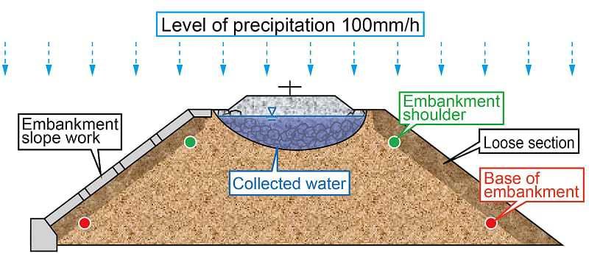
Technological Solution
GIS based Embankment mapping for monitoring the critical sections in prone areas.
Crowdsourced health-card for taking preventive measures from flood.

Slide 5
INTRODUCTION :- EMBANKMENT
A wall or bank of earth to prevent a river flooding.
Constructed using non-aerated and waterproofed material.
Provides adequate support and a stable long-term level surface.
Needed when sub grade line of highway raises ground level.
Purpose:
Water storage
Barrier protection
Types:
Earth Filled
Rock Filled

Slide 6
Existing Inspection Methods
Ground survey
Aerial observation
Flood mapping
DISADVANTAGES
Very high manpower requirement for surveying.
Bad weather conditions affects timely aerial observations.
If flood occurrence is extensive, it is difficult to monitor flood event accurately and very quickly.

Slide 7
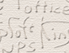
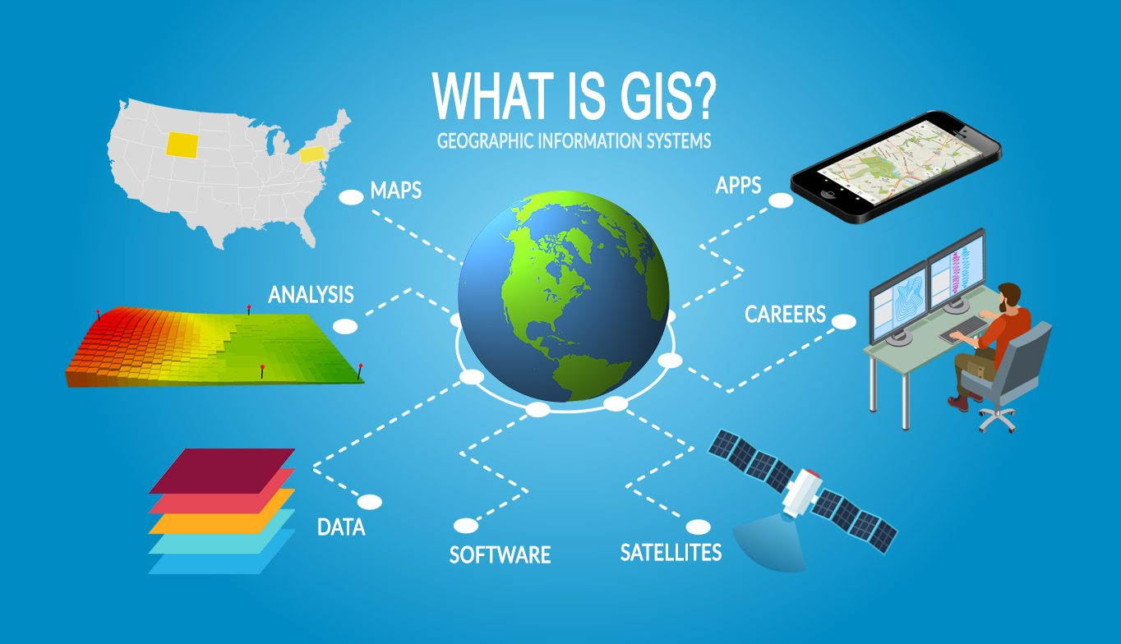
GIS BASED MAPPING
GIS (Geographic Information System) allows mapping the geographic area.
Provides 3D analysis of a specific or nearby area.
Provides cartographic data, photographic data, and digital data.
Map data includes location of rivers, roads, hills, and valleys.

Slide 8
Embankment Survey & Monitoring using UAV
Unmanned Aerial Vehicle (UAV) in airborne surveys provide
Risk reduction,
Better overview,
Survey of inaccessible locations,
Improved data density,
Faster data acquisition,
Higher data resolution and Lower costs.
md4-1000 UAV can be used for survey and monitoring.
High Definition (HD) RGB camera can be used for capturing HD images of river embankments.
Recorded images are used to perform data acquisition process.

Slide 9
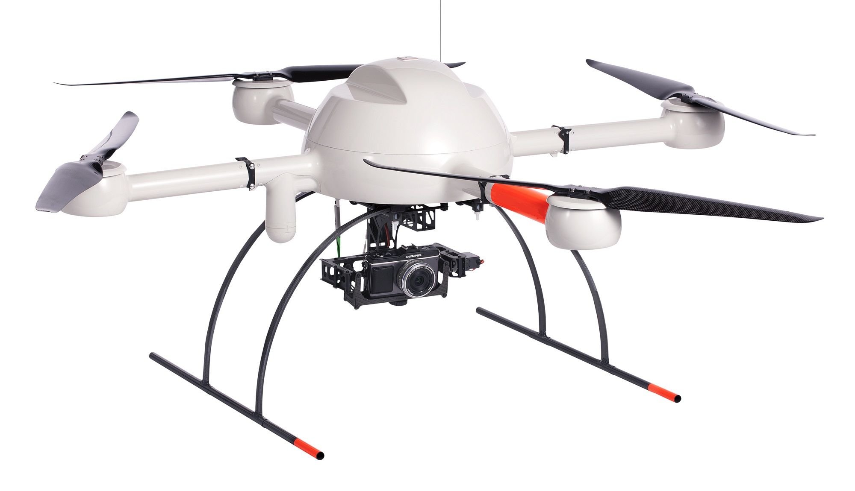
MD4-1000 UAV for Monitoring and Surveying
MD4-1000 UAV for surveying

Slide 10
Ground Control Points (GCPs) collection
Use Differential Global Positioning System (DGPS) for improved location accuracy.
Collect GCPs in Geographic Coordinate System (GCS) and vertical reference with respect to ellipsoidal heights.
Collect multiple GCPs of the river embankment area for processing the data.
Transform the data into
Point clouds
Orthomosaics/Orthophotos/images
Digital surface models (DSMs) using UAV data processing software.

Slide 11
Generation of Point Cloud, (DSM) and Ortho rectified image.
Point clouds: sets of data points in a 3D coordinate system that represent external surface of a terrain or object.
Orthomosaics/Orthophotos/images: files containing aerial photographs geometrically corrected so that the scale is uniform with ground sampling distance (GSD).
Digital surface models (DSMs): files containing elevations that include buildings, vegetation, power lines and other above-ground objects. The ground is only seen when there is nothing else on it.

Slide 12
Points cloud: External surface of a terrain

Slide 13
Orthomosaic/ orthophoto

Slide 14
Digital Surface Model

Slide 15
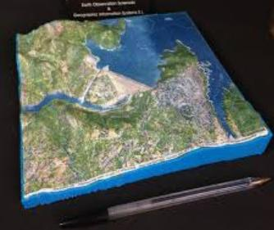
GIS 3d Mapping Of Embankment
Real world representation of embankment in 3D view.
Better visualization of the geographical coordinates.
Easy to identify the critical point based on the changes in the coordinates
By comparing present view with already captured view of the embankment.

Slide 16
3D view of River structure captured using UAV

Slide 17
GIS Based Monitoring: How it works?
UAV captures high resolution images of river system for monitoring of Embankment health.
Capture Horizontal resolution of image (5cm) and vertical resolution of image (20 cm) to create a Digital Elevation Model.
Longitudinal and Cross sectional profile reflects structural deformations of the Embankments.
Longitudinal profile prepared from the Digital Elevation Model of UAV image is used to check whether gradient of river embankment is uniform or non-uniform.
Depressions in some places can be revealed by the cross-sectional profiles prepared in locations of both of the embankments.
Cross-sectional profiles can be used to determine whether top width, bottom width and height of embankment are uniform or non-uniform.

Slide 18
GIS Based Monitoring: How it works? (Cont..)
Spatial database (DBMS) and a webGIS can be used to store, validate, map and display the data to assist the decision makers in managing an Early Warning Systems (EWS).
Sensor Observation Service (SOS) is developed to link the database to the sensors (including geospatial data and manual measures).
webGIS could interact with users for displaying the data and collecting more additional information.
webGIS could display time series of data through graphs made with Open Flash Charts.
System, combining a spatial DBMS and a webGIS can facilitate the analysis and data sharing.

Slide 19
Different sections of Mapped embankments

Slide 20
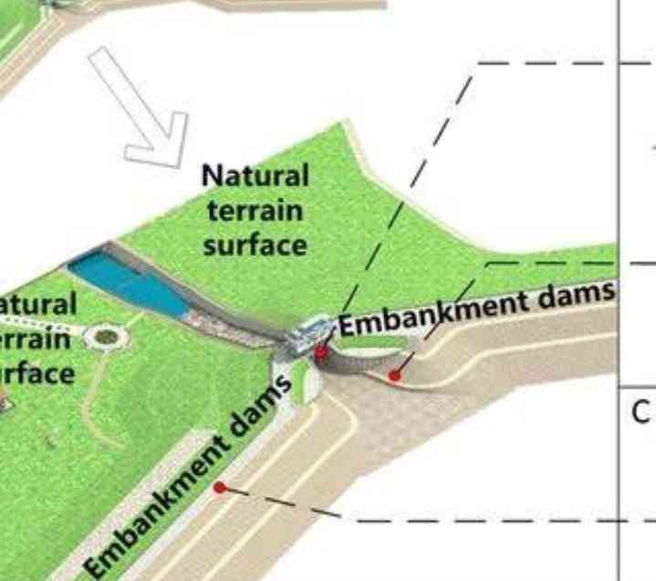
Process Flow
Capturing image of a river embankment by GIS mapping
A Graphic User Interface (GUI) is used to interact with the webGIS.
ACTOR
Request GIS mapping through GUI of webGIS to identify river condition using satellite imagery.
webGIS
Receives user request and displays the mapped geographical region accurately

Slide 21
GIS based Waterflow Control
Calculate inflow and outflow of water between cells in the geographical region based on weather scenario
Calculate water depth in each cells by interacting with the GUI.
Analyse the received satellite imagery of the weather scenario and 3D model of the embankment structure.
Based on the analysis control the flow of water by sending the analysis data to the control centre.
Send alerts or early warning to the control centre if there is any change in flow of water e.g. during heavy rain fall.
Early warning system creates emergency alert to evacuate people

Slide 22
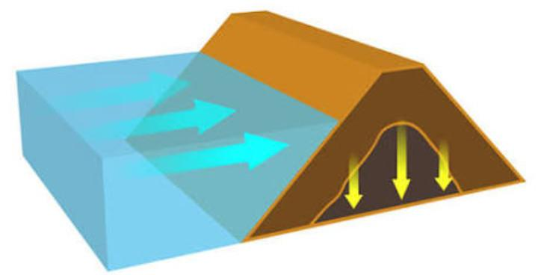
Water Inflow in the Embankment Structure

Slide 23
Crowdsourcing and Crisis-mapping
Crowdsourcing
Involves obtaining ideas, needed services, or content by soliciting web based contribution from a crowd.
Closely linked to potential and developments of information and communications technology (e.g. Internet and social media)
Types of crowdsourced tasks:
Problem solving
Data processing
surveillance or monitoring
Surveying

Slide 24
Crisis-Mapping
Crisis map is a real-time gathering, display and analysis of data during a crisis, including
political,
social and
environmental ones,
Having different development intensity (from slow-burn crises to sudden-onset disasters).
Allows a large number of people to control the carrying out of a crisis, by providing information to manage it.

Slide 25
Benefits of crowdsourcing and crisis-mapping:
Allows access to a large pool of participants.
Saving time in data collection.
Lowering costs of developing a crowdsourced data.
Increasing in health promotion, research and care.
Informal data sources, such as crowdsourcing, along with advances in wireless infrastructure, GPS capabilities, and sensors, allow to communicate forecasts and advisory information to those in affected areas prior to a disaster
Provides effective advice during and after disaster.

Slide 26
Health card and flood risk map
Based on the data collected from GIS mapping and crowdsourcing we can able to prepare an health card for an embankment structure.
Health card for the mapped embankment structure highlighted in Green indicates stable embankment structure.
Health card for the mapped embankment structure highlighted in Red indicates the presence of critical section in the embankment structure.
Also indicates the strength of inflow and outflow of water in embankment.
Flood risk map indicating red alert on the map can be generated, if the strength of the embankment is weak.
Early warning system can send emergency alerts after reviewing the health card of an embankment structure.

Slide 27
Showstopper details
Features of this technological solution are:
Providing a GUI for all functions in a single device.
Generating 3D model of an embankment structure.
Generating embankment health card.
Generating flood risk map to alert locals.
Safeguard the people before flood occurs.
Reducing the manpower and cost for surveying and monitoring embankment structure.

Slide 28
THANK YOU

